Slide 1
Iterator Design Pattern

Slide 2
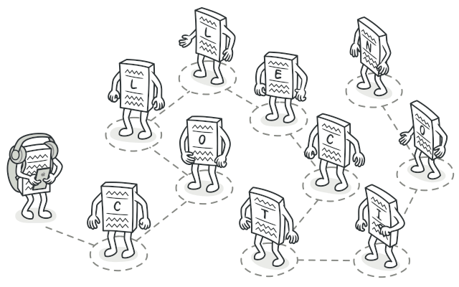
Iterator is a behavioural design pattern that lets you traverse elements of a collection without exposing its underlying representation (list, stack, tree, etc.).

Slide 3
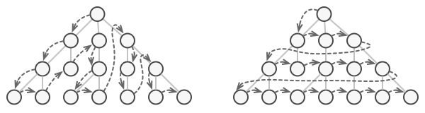
Problem
- Traversing simple collections (e.g., lists) is straightforward, but complex structures (e.g., trees) require varied traversal methods (depth-first, breadth-first, etc.)
- Adding traversal algorithms to collections blurs their primary role of data storage.
- Client code becomes tightly coupled to specific collection implementations, limiting flexibility and reuse.
The same collection can be traversed in several different ways.

Slide 4
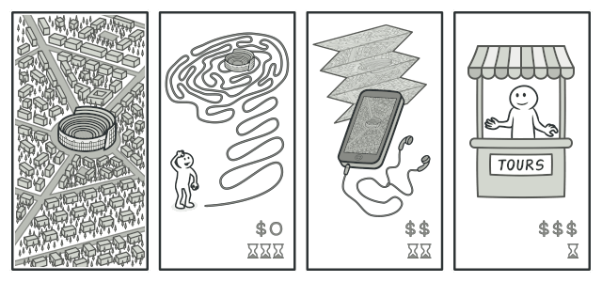
Real-World Analogy
All of these options
— the random directions born in your head, the smartphone navigator or the human guide
— act as iterators over the vast collection of sights and attractions located in Rome.
Colosseum
Self-exploration
virtual guide app
local guide
Various ways to walk around Rome.

Slide 5
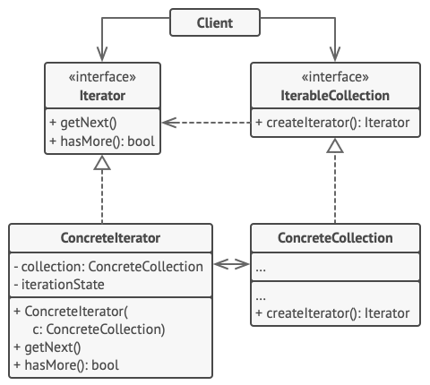
Structure of Iterator Pattern
Iterator Interface:
Declares methods for traversing a collection
(e.g., next(), hasNext(), reset).
Concrete Iterator:
Implements traversal logic for a specific collection.
Tracks traversal progress independently, enabling multiple iterators to operate on the same collection.
Collection Interface:
Declares methods for retrieving iterators.
Methods return iterator interface types, ensuring compatibility with various iterator implementations.
Concrete Collection:
Provides concrete iterators on request.
Houses additional collection logic not central to the pattern.
Client:
Operates with collections and iterators through their interfaces.
Decouples client logic from specific iterator.

Slide 6
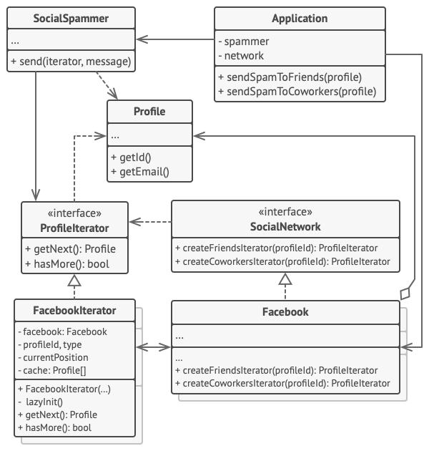
Pseudocode
Purpose of Iterator Pattern:
Allows traversal of a specialized collection (e.g., Facebook's social graph) through different iterators, providing flexibility in accessing data.
Friends and Colleagues Iterators:
The friends iterator retrieves a profile's friends, while the colleagues iterator retrieves profiles of colleagues working in the same company, both abstracting away implementation details.
Decoupled Client Code:
The client interacts with the collection and iterators through a common interface, avoiding dependency on specific classes or implementation details like authentication.
Extensibility:
Adding a new social network requires implementing new collection and iterator classes without modifying existing client code.

Slide 7
Applicability
Use the Iterator pattern when your collection has a complex data structure under the hood, but you want to hide its complexity from clients.
Use the pattern to reduce duplication of the traversal code across your app.
Use the Iterator when you want your code to be able to traverse different data structures or when types of these structures are unknown beforehand.

Slide 8
Pros and Cons of Iterator Pattern
Pros:
Single Responsibility Principle - You can clean up the client code and the collections by extracting bulky traversal algorithms into separate classes.
Open/Closed Principle - You can implement new types of collections and iterators and pass them to existing code without breaking anything.
You can iterate over the same collection in parallel because each iterator object contains its own iteration state.
Cons:
Applying the pattern can be an overkill if your app only works with simple collections.
Using an iterator may be less efficient than going through elements of some specialized collections directly.

Slide 9




THANK YOU
(844) 720-6678
info@simplifyhealthcare.com
simplifyhealthcare.com
Simplify Healthcare
U.S.: 600 N Commons Drive, Suite 110, Aurora, IL 60504
India: 401/402, 4th Floor, Pentagon P-2, Magarpatta City, Pune 411013
CONNECT WITH US
LinkedIn
YouTube
X
Instagram

